Slide 1
Digital Portfolio
TUDENT NAME: S. TAMILARASAN
REGISTER NO AND: 222404414
NMID:41FABE56DB9D532B9534C6EC1F22F5B2
DEPARTMENT: Bsc. Computer science
COLLEGE: COLLEGE/ UNIVERSITY:Agurchand manmull jain College/Madras University

Slide 2
PROJECT TITLE
HTML LABLES

Slide 3


AGENDA
Problem Statement
Project Overview
End Users
Tools and Technologies
Portfolio design and Layout
Features and Functionality
Results and Screenshots
Conclusion
Github Link
3/21/2024 Annual Review

Slide 4

PROBLEM STATEMENT
User experience — Users may get confused while filling out forms.
Accessibility — Screen readers cannot correctly interpret unlabeled inputs.
Form validation — Users may enter incorrect data if fields are unclear.

Slide 5

PROJECT OVERVIEW
This project focuses on using the HTML <label> element to create more accessible and user-friendly web forms. The <label> tag links text descriptions to input fields, helping users understand what information is required and improving navigation. Proper use of labels enhances the overall usability, supports screen readers, and ensures a better experience for all users while filling out forms.

Slide 6

WHO ARE THE END USERS?
The end users are individuals who interact with web forms on websites or applications.
They can include:
General Users – People filling out forms for registrations, logins, feedback, or purchases.
Visually Impaired Users – Users who rely on screen readers benefit from properly implemented <label> elements.
Elderly Users – Clear labels make forms easier to understand and navigate.
Mobile Users – Labels improve touch accessibility by making input selection easier.

Slide 7

TOOLS AND TECHNIQUES
Tools:
Code Editors – To write and edit HTML codeExamples: VS Code, Sublime Text, Atom
2. Web Browsers – To test and preview formsExamples: Google Chrome, Mozilla Firefox, Microsoft Edge
3. Accessibility Testing Tools – To check if labels work properlyExamples: WAVE, AXE, Lighthouse4. Screen Readers – To test label accessibilityExamples: NVDA, JAWS, VoiceOver
Techniques:
Using for Attribute – Linking <label> to the corresponding <input> using the input’s id.<label for="email">Email:</label><input type="email" id="email">
2. Wrapping Labels Around Inputs – Placing the input inside the <label> tag for automatic association.<label>Username: <input type="text" name="username"></label>

Slide 8
POTFOLIO DESIGN AND LAYOUT
The portfolio should have a clean and simple layout with sections like an introduction, projects, skills, and a contact form. The contact form demonstrates the proper use of the HTML <label> element by associating labels with input fields for better usability and accessibility. Labels improve form navigation, help screen readers, and create a user-friendly experience across devices.
!DOCTYPE html><html><head> <title>HTML Label Example</title></head><body> <h2>Registration Form</h2> <form> <label for="name">Name:</label> <input type="text" id="name" name="name"><br><br> <label for="email">Email:</label> <input type="email" id="email" name="email"><br><br> <label for="password">Password:</label> <input type="password" id="password" name="password"><br><br> <input type="submit" value="Submit"> </form></body></html>
8

Slide 9
FEATURES AND FUNCTIONALITY
Features:
Associates text descriptions with form inputs.
2. form usability by making labels clickable to focus inputs
.3. Enhances accessibility for screen readers and vis
ually impaired users.
4. Supports both for attribute linking and label-wrapping methods
.5. Works with various input types like text, email, checkbox, radio, etc.
Functional:When a user clicks on the label, the related input field is automatically activated.Screen readers announce the label text, helping users understand the purpose of the field. better form structure, readability, and user experience across devices and assistive technologies.

Slide 10

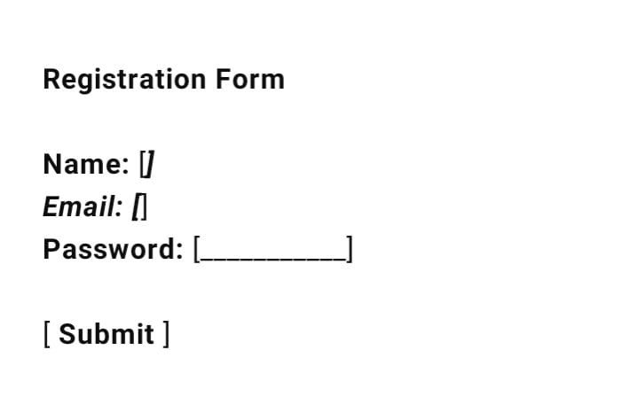
RESULTS AND SCREENSHOTS
Result: The HTML program successfully displays a simple registration form with properly associated <label> elements.
Result Screenshot:
3/21/2024 Annual Review
10

Slide 11
CONCLUSION
The project demonstrates the effective use of the HTML <label> element to create user-friendly and accessible web forms. By properly associating labels with input fields, the form becomes easier to navigate, improves usability, and supports screen readers for visually impaired users. This enhances the overall user experience and ensures better form accessibility across all devices and browsers.
11

